Slide 1
UNE Lessons Learned
Safe Workplace
Actions and Initiatives
UNE Safe Workplace Initiatives – SafeWork NSW
2023 – 2024 and Beyond

Slide 2
Lessons Learned from the
SWNSW Investigation
UNE’s maturity in the staff safety and wellbeing space was low
UNE needs a leadership team who understand safe workplace obligations and actively step into the safe workplace space
There are no quick fixes, UNE requires an ongoing program of work to ensure staff safety and wellbeing
UNE needs a sustainable safety and wellbeing framework and continue to measure this
There needs to be personal ownership of staff safety and wellbeing by UNE leaders. Staff safety and wellbeing needs to be embedded in team meetings, planning and the policy framework
UNE recognises that building a safe workplace culture requires a multi-faceted and multi layered approach

Slide 3
A Summary: UNE’s Response
As demonstrated in the following slides, the recent SafeWork NSW Improvement Notice led to UNE identifying and addressing gaps in its systems of work and overall workplace culture relating to psychosocial hazards
Institutional prioritisation of business planning with 4 areas of critical prioritisation one of which is Staff Satisfaction and Wellbeing, with KPIs cascading from UNE Council all the way through UNE to individual performance plans
As part of the Improvement Notice a review of all hazard reporting was performed, a gap analysis against the Code of Practice: Managing Psychosocial Hazards at Work conducted and a safe system of work implemented so that psychological risk factors arising from workplace practices were identified early and control measures implemented along with timely investigation processes
The Improvement Notice workplan included a targeted training program, Psychosocial Risk Management Framework with updated policy and guideline architecture and PPDR review, a revised WHS Hazard Register, independent Safety, Culture and Wellbeing Review and a Safe Communities Program
As a result of these actions, UNE gained further insight into its culture and psychosocial hazards and as a result has continued to implement a steady program of reform, including a 360 degree senior leadership review, Values and Behaviours Cultural Transformation Project, establishing a new dedicated position, Principal Lead – Student and Staff Safety and Wellbeing, extensive additional policy development to support the Psychological Risk Management Framework, overhauling management of staff complaints and grievance processes, with a focus on early intervention and informal conciliation meetings, with a significant decrease in grievances and resolution times and uplifting the Safe Communities Program to include a compliance tracker, dedicated steering committee, prevention initiatives and first responder training
Following the independent Safety, Culture and Wellbeing Review, the University has also rolled out extensive training, including WHS due diligence for officers, mental health and wellbeing, inclusivity, cultural and gender violence training along with a program of comprehensive leadership development
Specific improvements undertaken by UNE related to violence in the workplace are outlined on the final slide

Slide 4
UNE Safe Workplace Initiatives – SafeWork NSW
Timeline – Safe Workplace Actions and Initiatives: 2023 – 2024 and beyond
20 Sept 2022 | Safe Work Improvement Notice
16 Nov 2022 | Safety, Culture and Wellbeing Advisory Group established
18 Nov 2022 | Meeting with SafeWork Inspector to confirm approach and work in progress to comply with the Improvement Notice
28 Nov 2022 | UNE Initial Response to SafeWork NSW Improvement Notice
Feb 2023 | Ernst & Young engaged to undertake Safety Culture and Wellbeing Assessment
13 Mar 2023 | Meeting with SafeWork Inspector to discuss Safety Culture review timeline
Mar 2023 | Ernst & Young commence Safety Culture and Wellbeing Assessment
Mar 2023 | UNE Psychosocial Risk Management Framework developed
1 Jun 2023 | UNE Final Response to SafeWork NSW Improvement Notice
14 Jun 2023 | SafeWork confirmation UNE compliant with Improvement Notice
23 Jun 2023 | Safety Culture and Wellbeing Assessment Report received from Ernst and Young
July 2023 | Commence implementation of EY Report Recommendation Actions
18 Sept 2023 | Peter Berry Consultancy engaged to conduct a 360 Leadership Assessment for UNE Executive and designated senior leaders
25 Sept 2023 | 360 Leadership Assessment commenced
Sept 2023 | Appointment of a new ongoing position - Diversity and Inclusion Consultant
29 Nov 2023 | WHS Due Diligence Training sessions for all UNE Council and Executive commenced
Dec 2023 | Workload Management Toolkit launched
17 Jan 2024 | All Staff Forum with update on staff wellbeing program of works
19 Jan 2024 | Acumen Global Partners engaged to undertake Values and Behaviours Project

Slide 5
UNE Safe Workplace Initiatives – SafeWork NSW
Timeline – Safe Workplace Actions and Initiatives: 2023 – 2024 and beyond
24 Jan 2024 | UNE Leadership Development Guide launched
Jan 2024 – Apr 2025 | Review and uplift of PPDR process
Feb 2024 – Aug 2024 | Development of a campus wide Representation Action Plan
Feb – May 2024 | Black Dog Institute Managing for Team Wellbeing program sessions for people leaders
February 2024 | Review of UNE misconduct and complaint processes undertaken
February 2024 | SASH-GBV Steering Committee established
1 March 2024 | UNE dedicated 24/7 Crisis Support Line for staff launched
March 2024 | Collaboration with Dept of Communities & Justice Make no Doubt campaign
11 April 2024 | All Staff Forum with update on staff wellbeing program of works
24 April 2024 | Safe and Respectful Behaviours Policy and Procedure published
May 2024 | Full Stop Australia gender-based violence and positive duty training sessions
May 2024 | Workplace investigation training for workplace relations, business partner, WHS and student grievance unit staff
May 2024 | Disclosure process reviewed and centralised disclosure reporting regime introduced
June 2024 | All Staff Forum with update on staff wellbeing program of works
June 2024 | Appointment to Principal Lead Culture and Safety role
June 2024 | Senior Leadership Team Presentation on Positive Duty
June 2024 | Collaboration with Dept of Communities & Justice coercive control campaign
June 2024 | Suicide prevention training from Universities Australia launched
June 2024 | Emergency contact notices created and placed in every occupied college room & bathroom & strategically throughout academic campus

Slide 6
UNE Safe Workplace Initiatives – SafeWork NSW
Timeline – Safe Workplace Actions and Initiatives: 2023 – 2024 and beyond
18 July 2024 | First Responder and Support Network project commenced
July – Sept 2024 | Review and updating of the Performance Management Toolkit
August 2024 | All Staff Forum with update on staff wellbeing program of works
August 2024 | Residential College Culture Review commenced
August 2024 | Revamped Leadership Development Training program launched
August 2024 | Launch of SBS Inclusion Appropriate Workplace Behaviour program
August 2024 | Appointment of a new position – Specialist Industrial Relation Consultant
June – Sept 2024 | Revision of WHS Assurance policies and procedures
June 2024 | FWC Sexual Harassment at Work training launched
September 2024 | Staff Engagement Survey 2024 launched
Sept – Nov 2024 | Amendment of mandatory induction training to include SBS Inclusion Aboriginal and Torres Strait Islander course, Fair Work Commission Sexual Harassment at Work course and DEI training course
Sept – Nov 2024 | SmartCulture Bystander Intervention Training sessions
Sept – Dec 2024 | Revision of Sexual Harm Policy & Procedure
Sept – Dec 2024 | Drafting and implementation of Workload and Fatigue Policy & Procedure
Sept – Dec 2024 | Revision of Residential College Code of Conduct
Early 2025 | Safe Communities collaboration with CAPS - UNE Sexual Assault Student Advisory Group
Early 2025 | Interactive web-based decision tree for staff and students SASH & GBV support and reporting
By mid 2025 | Drafting and implementation of Change Management Policy & Procedure
By mid 2025 | Establish UNE mentoring programs – professional, academic and women

Slide 7
UNE Safe Workplace Initiatives – SafeWork NSW
An overview of notable UNE
actions and initiatives
commenced 2023 and 2024

Slide 8
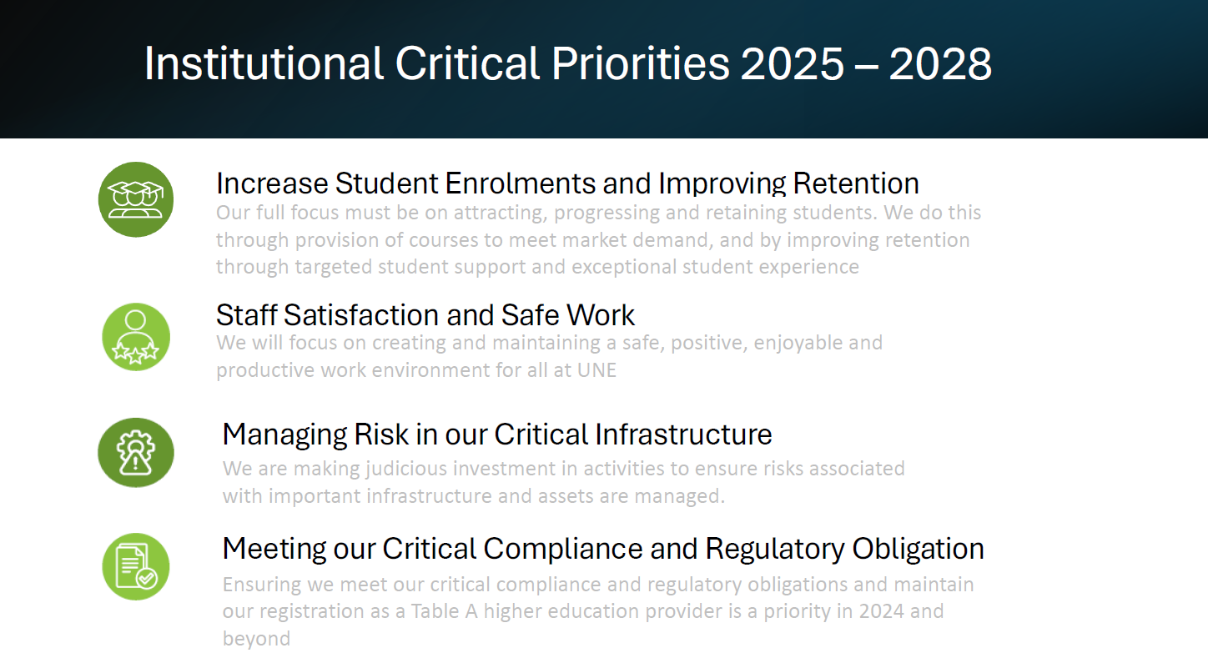

Slide 9




2024 UNE Business Plan Objectives
Increase Student Enrolments and Improving Retention
Meeting our Critical Compliance & Regulatory Obligation
Managing Risk in our Critical Infrastructure
Staff Satisfaction and Safe Work
2025 Objective
Improve UNE’s overall students’ success and outcomes to drive retention across all cohorts
International growth
New course growth
New market growth
Increased on campus cohort
2025 Objective
Increased staff satisfaction at work
Maintaining a diverse staff cohort
Staff have safe workloads and are able to manage their work/life balance
Staff are safe in their work environment
2025 Objective
Meeting the accreditation requirements as a Table A university
Meeting the research activity requirements to maintain university status
Meeting our requirements of professional accrediting bodies
Meeting our obligations to our industry and community
2025 Objective
Maintaining a safe and functional digital environment
Our built environment is safe and fit for purpose
Caring for and addressing our ageing infrastructure
Ensuring the long-term value of our physical assets
Building our AI future

Slide 10
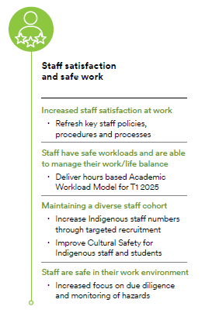
UNE’s Critical Priorities and Business Plan Objectives flow down into
portfolios, directorates, teams and individual performance plans
Example: Chief Operating Officer portfolio
Example: Deputy Vice-Chancellor portfolio

Slide 11
UNE Safe Workplace Initiatives – SafeWork NSW
Leadership 360 Review (Sept 2023 – July 2024)
UNE engaged Peter Berry Consultancy to to conduct a 360 Leadership Assessment for UNE Executive and designated senior leaders. This involved:
A 360 survey for leaders and individual report generation
Individual leader reports to facilitate development conversations
Individual debrief sessions on each person’s results including development action planning
Aggregated 360 report for cohorts for thematic reports and training needs analysis
Group briefing and introduction session on the process
Thematic report and training needs analysis for Executive team
Implementation roadmap
The survey tool focused on the key leadership success factors that will assist this leadership group to be more effective and empathetic leaders of an organisation that prioritises trust, respect and psychological safety in the workplace and to
build safety leadership capability across all levels of the organisation.
The leadership review was finalised in April 2024 and the thematic reports presented by PBC to Executive July 2024. The University is in the process of translating the implementation into actions with priorities being:
Supporting leaders to address themes across their areas
Mapping needs with training offerings
Encouraging better utilisation of EAP My Coach program for executive coaching
Establishing a mentoring program for existing and emerging leaders
Encouraging participation in the UNE Leadership Development Training program

Slide 12
UNE Safe Workplace Initiatives – SafeWork NSW
Acumen Global Partners Values and Behaviours Cultural Transformation Project
UNE has engaged Acumen Global Partners to address current and historical issues related to organisational culture, with a focus on developing and embedding a shared set of values and signature behaviours across the institution. The purpose of the project is to:
Build an aligned culture where the whole UNE community rally together, align and work together to create a thriving future state
Build a bridge from the past to the future
Build a new sense of shared aspiration, for people to find purpose in eliciting and embedding meaningful values and signature behaviours
Design Principles
Co-design - Acumen works closely with UNE people to design and deliver the project elements
Leader led – Executive, Senior Leaders team and other leaders be assisted to demonstrate through their consistent daily words and actions a recalibrated approach to leading UNE, in alignment with desired cultural aspirations.
Grassroots activation - Co-designed programs and activities invite collective engagement from across UNE, with a focus on current real-life issues that matter to those involved.
Shared outcomes
A cross section of the organisation can acknowledge the impact of the past on present experience and is willing to move toward an inspiring future state
A cohort of senior executives and others are engaged and doing the work of demonstrating the behaviour they wish to see
An empowerment movement is arising across and deep within UNE – willing to collaborate in safe to fail ways
Senior leaders and people managers are enrolled and supported to steward and model the behaviour UNE wishes to see
People deep within the organisation have a voice to influence positive change
Acumen engaged with key stakeholder groups (VC, office of strategy, Senior Executive and UNE council) in addition to almost 100 staff in small group or 1-1 discussions. The preliminary findings identified that UNE culture is characterised by ‘pride and possibility’, and that staff wanted scope to engage in their professional identity in a safe workplace. All that staff noted a sense of ‘community and belonging’ however work on diversity and inclusion was required moving forward. Phase 1 will take these learnings and co-develop with PL and UNE staff, a set of enabling behaviours and guidelines, to facilitate safe engagement followed by a grass roots program to socialise the behaviours. Acumen's approach is to work alongside and support UNE to design and deliver this project, while remaining responsive to emerging needs and circumstances.

Slide 13
UNE Safe Workplace Initiatives – SafeWork NSW
Appointment of Principal Lead – Student and Staff Safety and Wellbeing
The Principal Lead was appointed on 17 June 2024 to:
devise, implement, monitor, and evaluate a program of strategic initiatives to establish and safeguard a positive, safe and resilient organizational culture.
champion a culture that prioritises the safety and well-being of all staff members and students
work closely with the Vice-Chancellor, executives and staff across the University
act with a high degree of empowerment to elevate the University of New England's culture and prioritize the mental health of its workforce and students.
operate in a manner which ensure safety for UNE’s Aboriginal and Torres Strait Islander staff and students, by ensuring that the need for psychosocial safety is connected with cultural safety
assist in creating an environment characterized by equal access and respected participation of all groups and individuals regardless of cultural, ethnic, racial, gender, age, religious differences, abilities and disabilities, and sexual orientation
The Principal Lead will, amongst other things, expertly apply advanced organisational psychology principles and frameworks to conceive, design, and implement the initiatives required to establish and maintain an organisational culture characterised by psychological safety and staff and student well-being; undertake significant high-level planning and analysis including benchmarking, (nationally and internationally) to optimise the quality and impact of the programme of cultural change initiatives and establish metrics and reporting systems to monitor the effectiveness of safety and well-being projects.
Two key strategies have been enacted to date to facilitate a momentum for change:
Strategic project plan that identifies milestones, reporting and deliverables relevant to strengthening culture at UNE. Endorsed by VC and included in the UNE Project Management Framework.
Design and approval of terms of reference for the Culture Network Committee.
The first step of the Culture Network committee will be to engage as part of the momentum team with Acumen in August 2024.

Slide 14
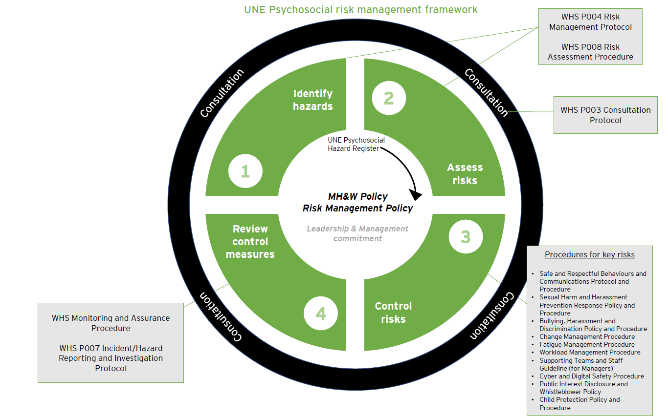
UNE Safe Workplace Initiatives – SafeWork NSW
UNE Psychosocial Risk Management Framework
Development of a Psychosocial Risk Management Framework was a key action in early 2023 as a response to changing legislation and the SafeWork NSW Improvement Notice. The Framework is designed to ensure the University has a robust suite of policies, procedures and guidance material.

Slide 15
UNE Safe Workplace Initiatives – SafeWork NSW
UNE Psychosocial Risk Management Framework – Maturity Level
Policies and Procedures for WHS
Policies and Procedures for key psychosocial risks
Related guidance
Work Health and Safety Rule |  | Safe and Respectful Behaviours Policy and Procedure |  | Staff Complaints & Grievances – Enterprise Agreement
WHS Organisational Responsibilities Policy and Procedure |  | Sexual Harm and Gender Based Violence Policy and Procedure |  | Staff Complaints – UNE Representatives not covered by Enterprise Agreement
WHS Incident/Hazard Reporting and Investigation Policy and Procedure |  | Workload and Fatigue Management Policy and Procedure |  | Student Grievance Handling Policy and Procedure
WHS Risk Management Policy and Procedure |  | Change Management Policy and Procedure |  | Code of Conduct
WHS Consultation Policy and Procedure |  | Occupational Stress Policy and Procedure |  | Flexible Working Policy
Mental Health Policy and Procedure |  | e-Safety Policy and Procedure |  | Core Capability Framework
Return to Work Policy |  | Prevention of Bullying, Harassment and Discrimination Policy and Procedure |  | Workforce Planning Framework
WHS Assurance and Monitoring |  | Child Protection Policy and Procedure |  | Reporting Wrongdoing at UNE Policy
WHS Hazard Register |  |  |  | Position Descriptions
Current
Revision
Development

Slide 16
UNE Safe Workplace Initiatives – SafeWork NSW
Improvements to Complaints/Grievance Processes
UNE has taken a number of steps to improve the complaints and grievances processes which are enshrined in the Enterprise Agreements. Some of the notable actions are:
Creation of a complaints/grievances dashboard for the Executive team, which allows them to see emerging trends within their portfolios and encourage action to resolve
Updating the People & Culture webpage to contain a dedicated link to complaints and grievance information including a complaints and grievances process map, complaints pathways for staff, information sheet for complainants, and an information sheet for respondents
Updating of process documentation such as letter and decision templates, guidance material for supervisors and University Officers facilitating informal resolution of complaints and/or making decisions, process guidance material for respondents, and guidance for support persons.
Providing information sessions for supervisors and other University staff regarding facilitating informal resolution or acting as University Conciliator
Engaging a wide pool of senior leaders to act as University Conciliators in complaints/grievances processes
Reintroducing leadership development training in 2024 to upskill managers including in how to deal with complaints, performance management and having difficult conversations. This training should assist supervisors to identify issues early on and give them the skills to address those issues before they turn into a complaint.
A focus on early intervention by the People and Culture Business Partner team and the People and Culture Workplace Relations team has assisted in resolving issues before they become complaints. These steps have seen an increase in the number of informal conciliation meetings.
This has resulted in a significant decrease in the number of complaints/grievances being lodged in 2024 compared with 2023. The average time taken to resolve complaints/grievances has also reduced significantly from 170 days in 2023 to 15.4 days in 2024.

Slide 17
UNE Safe Workplace Initiatives – SafeWork NSW
Uplift of Safe Communities Program
The Safe Communities Program holds primary responsibility for coordinating whole of University compliance with SASH and GBV obligations, working closely together with the Student Experience portfolio (particularly the Student Grievance Unit (SGU) and student Counselling and Psychological Service (CAPS)) as well as the Director Residential System
In 2024 Safe Communities developed a SASH and GBV Compliance Tracker to track the University’s extensive (264 +) SASH and GBV obligations in this area, as well as the University’s processes, policies and activities both current and planned (230+) that ensure the University is complying with those obligations
In 2024 the SASH/GBV Steering Committee was stood up and meets monthly to discuss SASH and GBV compliance, activities being undertaken, potential collaborations and who will take responsibility for required compliance actions.
A number of collaborative projects are underway for 2024 – 2025 including a Student Lived Experience SASH Advisory Group (CAPS and Safe Communities collaboration); the Make No Doubt Campaign (Safe Communities, Residential Colleges, UNE Life, UNE Media & Department of Community & Justice); Coercive Control Campaign (Safe Communities, Colleges, UNE Life, Media & Dept of Community and Justice); and a First Response & Support Network (Safe Communities, CAPS, Student Experience, SGU).
Although prevention is the primary focus of the SASH and GBV obligations, responding appropriately to disclosures of a SASH incident in a trauma informed, victim driven manner is an equally important obligation. In March 2024 it became requirement of all staff members and residential leaders who receive a disclosure, or who are told about a disclosure, to refer the disclosure to the Safe Communities Program. The Safe Communities Program keeps a database of all disclosures which is anonymised, and records the time, date and location of the incident, as well as the nature of the incident, but does not record the name of the discloser or the alleged perpetrator. This database helps us to track the number of SASH incidents occurring and to identify themes, which in turn informs actions that can be taken to address risks
In 2024 First responder training is being provided to staff and students who most commonly received disclosures, so that they can feel confident in listening to the discloser, ensuring the discloser’s immediate safety, and knowing who to call to arrange immediate access to medical treatment for the discloser if needed. The person receiving the disclosure will also be able to provide information to the discloser about counselling services and will seek the discloser’s consent to notify appropriate staff (such as a Head of College) to assist in arranging help for the discloser

Slide 18
UNE Safe Workplace Initiatives – SafeWork NSW
Immediate Safe Workplace Training 2023
As an immediate response after Ernst and Young Culture Review, the University provided the following training:
Due Diligence Training for University Officers
Commencing 29 November 2023, the University engaged Minter Ellison to provide a series of WHS Due Diligence training sessions to UNE Council, Executive and other persons who would be deemed as officers under the WHS Act. Recent Council and Executive appointees completed this training on 21 August 2024 with Minter Ellison. This training is now being facilitated by the UNE WHs team as an ongoing training offering to all UNE staff.
Black Dog Mental Health and Wellbeing Training
Throughout 2023 and early 2024 the University hosted a series of Black Dog Institute in person and online training sessions for 201 leaders and supervisors. The training focussed on practical strategies to promote team wellbeing; awareness of how mental illness may manifest in the workplace; supportive conversations about mental health; and the role of leadership in supporting people with mental illness.
In October 2023 Managing for Team Wellbeing training was provided to enable awareness, prevention and support for people experiencing mental health symptoms or conditions as a key control to manage psychosocial risk in the workplace. The improvements achieved from the training was increased awareness of mental health and the signs of mental health issues, and increased reporting of mental health hazards due to better awareness.
UNE will continue to make further resources available for embedding the learnings available to staff on the Wellbeing Hub webpage; continue to run follow up articles in the weekly People and Culture newsletter to encourage embedding of the learnings; and consider further training needs and offerings.
This training is now being offered on an ongoing basis to all UNE staff.

Slide 19
UNE Safe Workplace Initiatives – SafeWork NSW
Ongoing Safe Workplace Training Offerings
UNE has significantly increased its training offerings in 2024 to support staff to engage in a safe and inclusive workplace. A sample of some of the ongoing training offerings aimed at promoting a safe and inclusive workplace include:
In house face to face and virtual live External Virtual Live
WHS Due Diligence training Pride in Diversity LGBTQ+ Awareness Training
Managing for Team Wellbeing Pride in Diversity Trans & Gender Diverse Awareness Training
Leadership Development Training (including Leading Psychologically Safe Teams) Pride in Diversity LGBTQ+ HR and Recruitment Training
Cultural Connections Black Dog Workplace Mental Health for Leaders
Acknowledgment of Country
Online self-paced External face to face
SBS Inclusion Appropriate Workplace Behaviour Course Mental Health First Aid
SBS Inclusion Core Inclusion Course (diversity and inclusion)
SBS First Nations Course
SBS Inclusion Cultural Diversity Course
SBS Inclusion LGBTIQ+ course
SBS Inclusion Disability Course
SBS Inclusion Gender Equity Course
SBS Inclusion Generational Diversity Course
Workplace Mental Health for Leaders
UNE Manager’s Toolkit
UNE People Leaders Workload Toolkit
ADCET Disability Awareness Training
Consent Matters training
Responding to Disclosures of Sexual Violence training
FWC Sexual Harassment at Work training
OCG Child Safety eLearning course
Universities Australia Suicide Prevention Training

Slide 20
UNE specific improvements related to specific conduct in the Workplace
UNE has implemented a number of improvements to address violence, aggression, bullying, harassment and discrimination. This includes:
  Improved thematic monthly analysis of reported hazards to identify areas of concern
  Improved time for management of WHS hazards and incidents, with the average time for closure of hazards rated mod-high and above reducing from 62 to 34 days, and the average time for closure of incidents rated mod-high and above reducing from 31 to 15 days
  Creation of a complaints/grievances dashboard for the Executive team, which allows them to see emerging trends within their portfolios and encourage action to resolve
  Improved early intervention by the People and Culture Business Partner team when concerns are raised, to address issues before they escalate to workplace violence
  Anonymous Staff Engagement Survey being run in September 2024 which contains questions about workplace violence
  Safe and Respectful Behaviours Policy and Procedure published in March 2024 to enforce that workplace violence will not be tolerated, and clearly set out avenues for reporting workplace violence
  Improved complaints/grievance process to ensure workplace violence matters are dealt with swiftly
  Increased training offerings including Full Stop Australia gender-based violence and positive duty training sessions, bystander training, SBS Inclusion Appropriate Workplace Behaviour program and Fair Work Commission Sexual Harassment at Work course
  Weekly articles in the People and Culture newsletter on topics such as sexual harassment at work, diversity and inclusion at work, appropriate workplace behaviour
  Increased promotion of diversity and inclusion at UNE to reduce violence towards diverse groups including through the Representation Action plan, IDAHOBIT morning tea, Rainbow Walk, dedicated Queer Space and participation in the Workplace Equality Index (WEI) survey

